Slide 1
A Look At CIS Security Benchmarks (3)
CIS Benchmarks example (Network Devices)

Slide 2
A Look At CIS Security Benchmarks (3)
# | OVERALL CIS BENCHMARK CATEGORIES | TOTAL
1 | OPERATING SYSTEMS | 36
2 | SERVER SOFTWARE | 33
3 | CLOUD PROVIDERS | 2
4 | MOBILE DEVICES | 8
5 | NETWORK DEVICES | 6
6 | DESKTOP SOFTWARE | 21
7 | MULTIFUNCTION PRINT DEVICES | 1
 | GRAND TOTAL CIS BENCHMARKS | 107

Slide 3

A Look At CIS Security Benchmarks (3)
June 29, 2016
174 pages PDF doc

Slide 4
A Look At CIS Security Benchmarks (3)
Control content:
Profile applicability (ASA 8.X, ASA 9.X)
Description
Rationale
Audit
Remediation
Default value
References

Slide 5
A Look At CIS Security Benchmarks (3)
1.8 (page 88); Session Timeout
Profile applicability: Level 1, Cisco ASA9.X
Description: Sets the idle timeout for a console session before the security appliance terminates it.

Slide 6
A Look At CIS Security Benchmarks (3)
1.8 (page 88); Session Timeout
Rationale: Limiting session timeout prevents unauthorized users from using abandoned sessions to perform malicious activities.

Slide 7
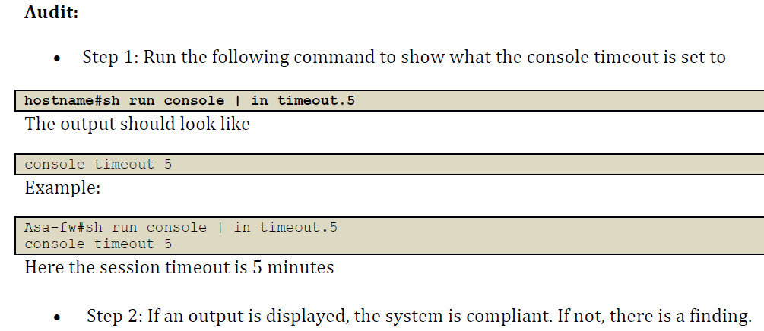
A Look At CIS Security Benchmarks (3)

Slide 8
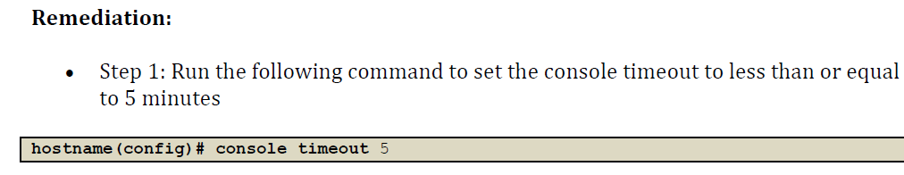
A Look At CIS Security Benchmarks (3)

Slide 9
A Look At CIS Security Benchmarks (3)
1.8 (page 88); Session Timeout
Default Value: The default timeout is 0, which means the console session will not time out

Slide 10
A Look At CIS Security Benchmarks (3)
1.8 (page 88); Session Timeout
Reference: CLI Book 1: Cisco ASA Series General Operations CLI Configuration Guide, 9.1

